Slide 1
Number Puzzles

Slide 2
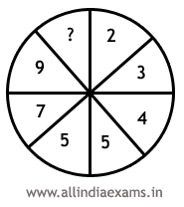
10
11
9
None of these
Answer: 11
The numbers in the right half from the series : 2, 3, 4, 5 The numbers in the left half from the series : 5, 7, 9, 11

Slide 3
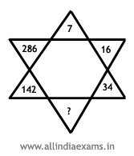
62
70
82
None of these
Answer: 70
7x2+2= 16;
16x2+2 = 34 and so on. So missing number = 34x2+2 = 70

Slide 4
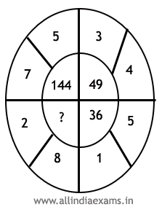
A.64
B. 81
C.100
D. 121
Answer: 100
(7+5)² = 144; (3+4)² = 49; (5+1)² = 36. So, missing number = (2+8)² = 10

Slide 5
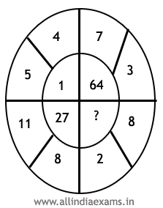
8
36
144
216
Answer: 216
(5-4)³ = 1; (7-3)³ = 64; (11-8)³ = 27. So the answer is = (8-2)³ = 6³ = 216.

Slide 6
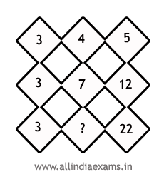
A. 10
B. 15
C. 17
D. 20
Answer: 10
We have, 3+4 = number below 4 =7; 3+4+5 = number below 5 = 12; 3+7+12 = number below 12 = 22; So, answer is = 3+7 = 10.

Slide 7
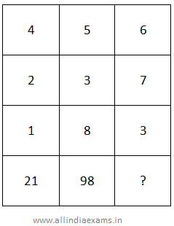
100
112
124
94
Answer: 94
Clearly, (1st row)² + (2nd row)² + (3rd row)² = 4th row.
Thus, in the first column, 4² + 2² + 1² = 21.
In the second column, 5² + 3² + 8² = 98.
In the third column,
missing number = 6² + 7² + 3² = 36 + 49 + 9 = 94.

Slide 8
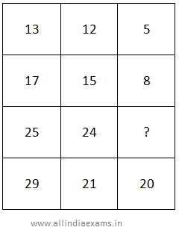
4
6
7
9
Explanation:
Clearly, (3rd column)² + (2nd column)² = (1st column)²
In the first row, 5² + 12² = 13².
In the second row, 8² + 15² = 17².
Let the missing number in the third row be x.
Then x² + 24² = 25² = x² = 49 => x = 7.

Slide 9
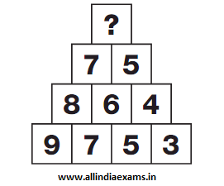
4
5
6
7
Answer: 6
Explanation:
Numbers in boxes from the second row up equal the average of the 2 numbers in the boxes directly below. Continue to the apex of the triangle.

Slide 10
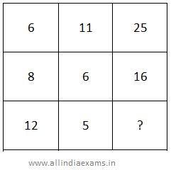
A. 20
B. 19
C. 17
D. 16
Answer: 16
In the first row, 11 * 2 + 6/2 = 25.
In the second row, 6 * 2 + 8/2 = 16.
In the third row, missing number = 5 * 2 + 12/2 = 10 + 6 = 16.

Slide 11
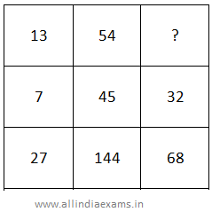
1
2
3
4
Answer: 4
In the first column, 13 + 7 * 2 = 27.
In the second column, 54 + 45 * 2 = 144.
Let the missing number in the third column be x.
Then, x + 32 * 2 = 68 => x = 4.

Slide 12
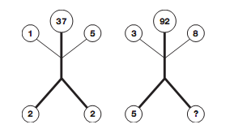
1
2
3
4
Answer: 4
Explanation:
In each diagram, read the upper and lower pairs of numbers as 2 digit values and add these together to give the result written at the top.

Slide 13
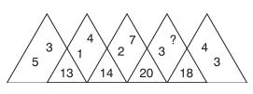
5
6
7
8
Answer: 8
Explanation:
Each number in the segment at the bottom is the sum of the four numbers in the sections either side. Thus 8 + 3 + 4 + 3 = 18.
So Answer is 8.

Slide 14
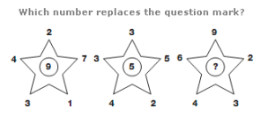
A. 11 B. 45 C. 10 D. 21
Answer : 10
In each star diagram, the number in the centre equals the sum of the top three numbers, subtracting the sum of the bottom two numbers.
4+2+7 – 3-1= 9
3+3+5- 4-2 = 5
6+9+2 -4 -3 = 10

Slide 15
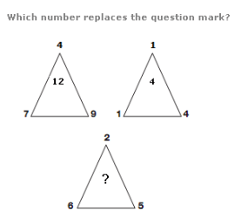
A. 9 B. 8 C. 4 D. 1 Answer : 9
The number at the centre of each
triangle equals the sum of the
lower two numbers
minus the top number.
7+9-4= 12
1+4-1 = 4
6+5-2 = 9

